Slide 1



ENRON Scandal & Its Implications in BE & CG
Prabesh Adhikari
Shishir Acharya
Subhechhya Tuladhar

Slide 2
Table of Contents
Introduction to Company
Hiring
Accounting System
Special Purpose Entity/Vehicle
Revenue and Profit

Slide 3
The Rise and Fall of Enron
Enron’s Growth and Expansion (1985-2000) Founded in 1985 as a natural gas company, Enron quickly became an energy trading giant. It leveraged deregulation to create new markets, driving its stock price to record highs.
Financial Fraud and Market Manipulation (1997-2001) Enron used Mark-to-Market Accounting to inflate revenues and Special Purpose Entities (SPEs) to hide debts, misleading investors about its financial health.
The Collapse of Enron (October 2001 - December 2001) Regulatory scrutiny exposed fraud, causing Enron’s stock to crash from $90 to under $1. On Dec 2, 2001, Enron filed for bankruptcy, marking one of the largest corporate collapses in history.

Slide 4
1. Introduction
Founded: 1985 by Kenneth Lay
Headquarters: Houston, Texas, USA
With the merger of Houston Natural Gas and InterNorth
Original focus: Natural Gas and Energy Trading
Major Player: Electricity, natural gas, communications and pulp & Paper Industry
Peak Success: Became one of the largest energy companies in the world, with a market value of over $60 billion.

Slide 5
1.2 Business Model
Transition from energy company to financial trading powerhouse
Use of complex financial instruments
Aggressive growth and expansion strategy

Slide 6
1.3 Key People
Main Executives Responsible
Whistle Blowers and Critics
Individuals who faced major consequences

Slide 7
a. Main Executives Responsible
Kenneth Lay (Founder & CEO)
Encouraged aggressive financial practices that led to the company’s downfall.
Jeffrey Skilling (CEO & COO)
Implemented the fraudulent mark-to-market accounting practices.
Andrew Fastow (CFO)
Orchestrated the use of Special Purpose Entities (SPEs) to hide debts and mislead investors.
Rick Causey (Chief Accounting Officer)
Helped manipulate financial statements and conceal fraud.

Slide 8
b. Whistle Blowers and Critics
Sherron Watkins (Vice President of Corporate Development)
Sent an internal memo warning of Enron’s financial mismanagement, later becoming a key whistleblower.
Jim Chanos (Hedge Fund Manager, Kynikos Associates)
Raised concerns about Enron’s stock valuation and financial practices before its collapse.
Bethany McLean & Peter Elkind (Journalists, Fortune Magazine)
Investigated and exposed major financial irregularities at Enron.

Slide 9
c. Individuals who faced major consequences
Kenneth Lay
Convicted of fraud and conspiracy in 2006; died of a heart attack before sentencing.
Jeffrey Skilling
Sentenced to 24 years in prison; later reduced to 14 years.
Andrew Fastow
Served 6 years in prison for his role in financial fraud.
Arthur Andersen LLP
One of the “Big Five” accounting firms, collapsed due to its role in Enron’s fraudulent accounting practices.

Slide 10
2. Hiring
Mr. Lay hired Consulting firm “McKinsey and Company”
Jeffery Skilling got appointed as consultant
Mr. Skilling started to work as consulted on business strategy
Enron started to invest in risky businesses

Slide 11
Skilling joined Enron | 1990 as COO
Hired Andrew Fastow as CFO
Mr. Fastow is known do complex billings and keep accounting complex
Very clear on how they will prepare financial statements and keeping the as complex as they could

Slide 12
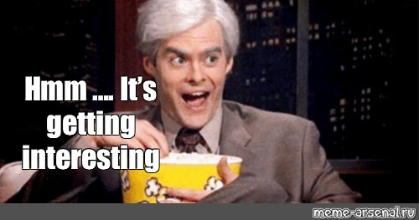

Slide 13
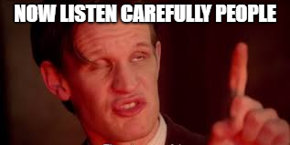
Further going on!!

Slide 14
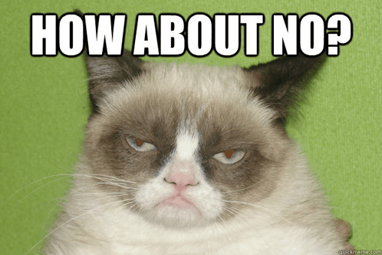
Performance Review System
Respect
Integrity
Communication
Excellence

Slide 15
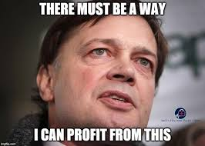

Yes! How much profit you can bring?

Slide 16
Diverging Investments
Internet Broadband
Power Plants
Commodity Trading

Slide 17
Further
Failed in many sectors
Faced Loss
Started to show fake revenues
Required Capital
Debt Plan

Slide 18
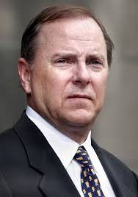
Hey Andrew, What should we do?
Hmm!! Let’s Brain Storm
New Accounting System!!
From 1992

Slide 19
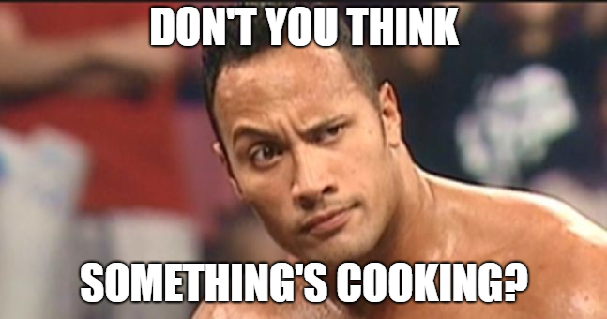
3. Accounting System
Historical Cost Accounting System
Mark to Market Accounting System

Slide 20
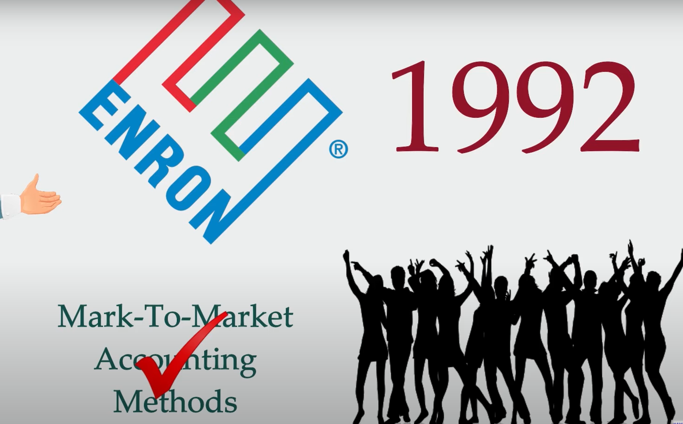
Let’s Party!!

Slide 21
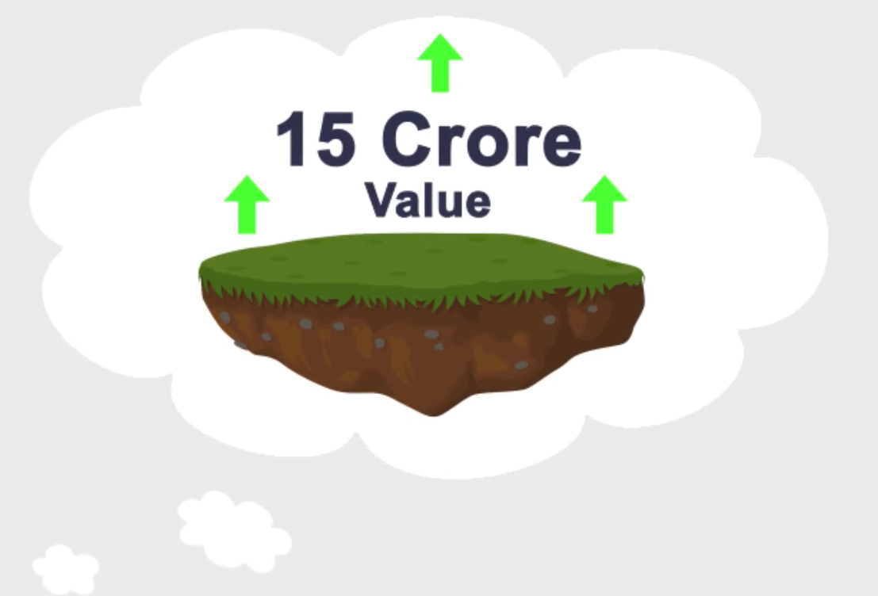
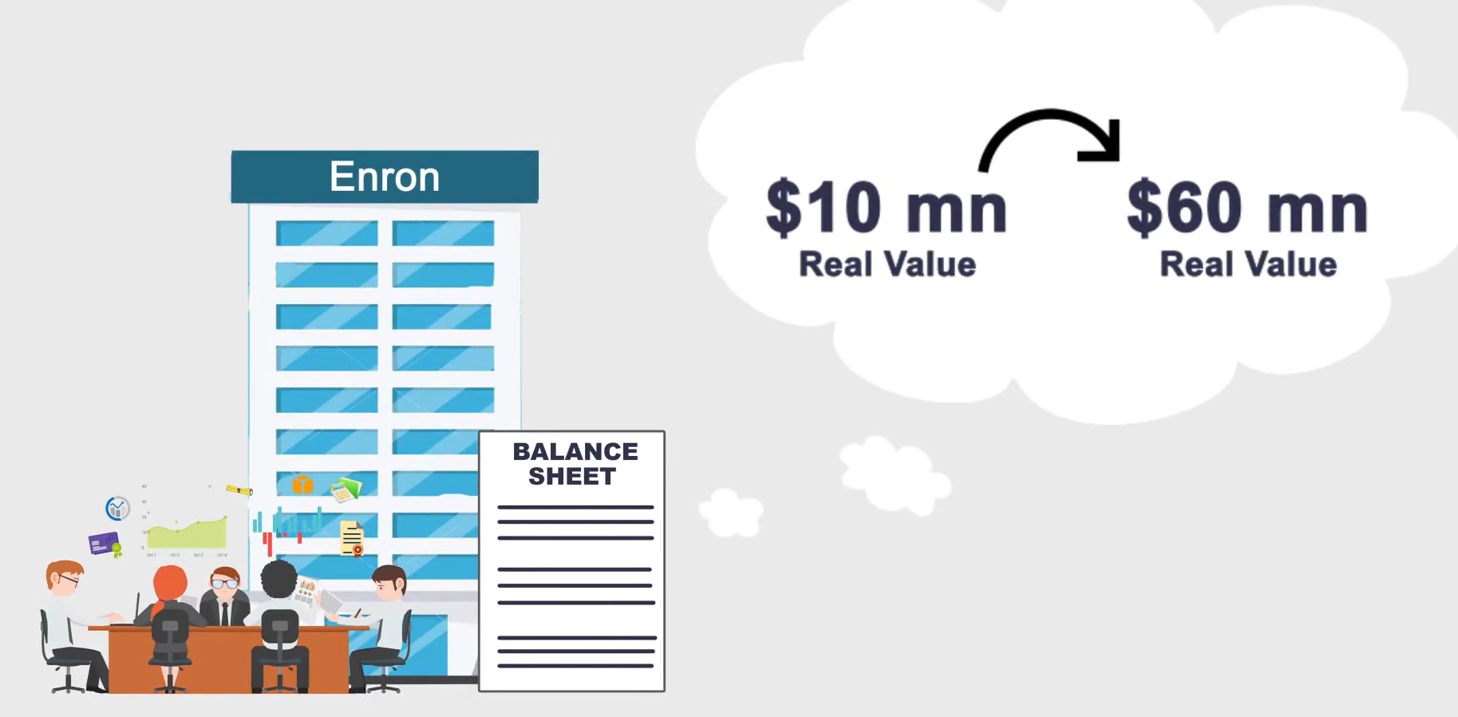
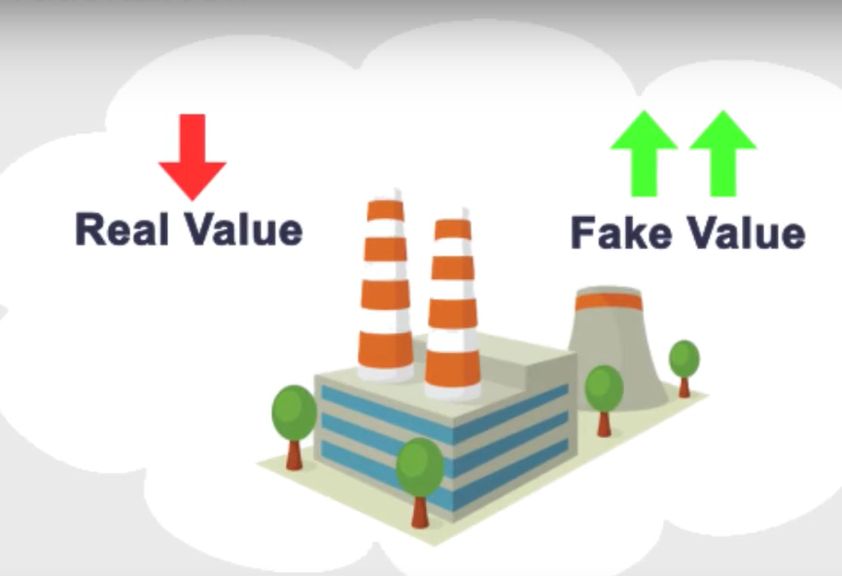
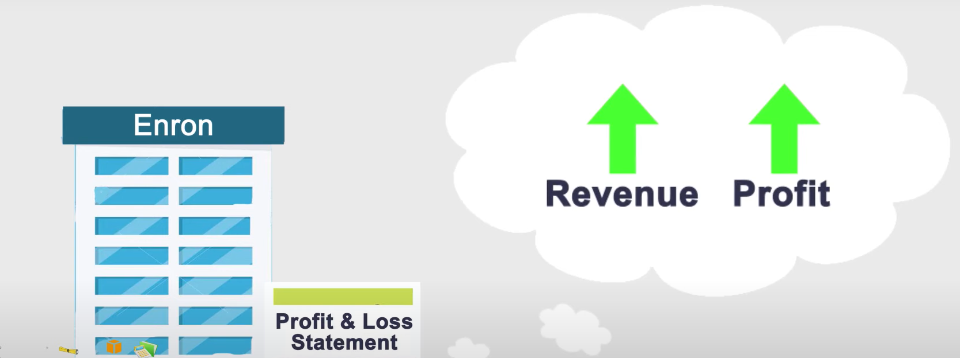
Fake Values

Slide 22
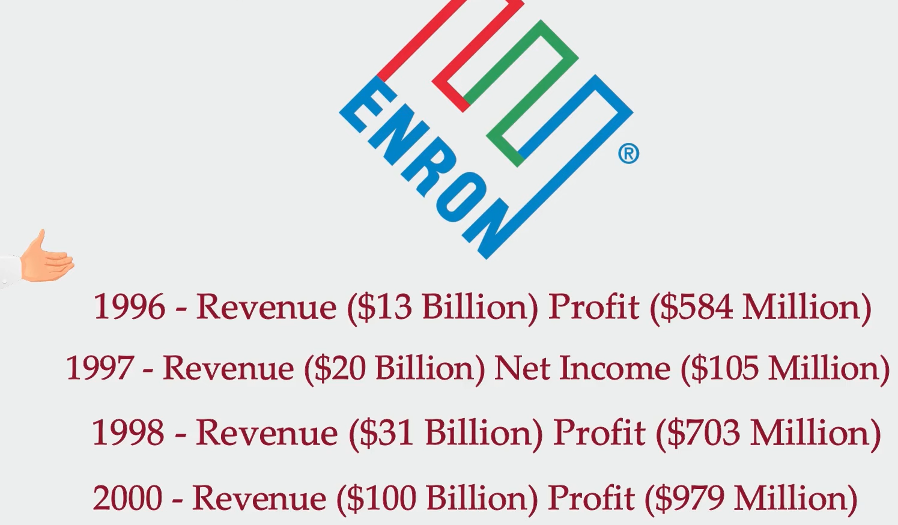

Slide 23
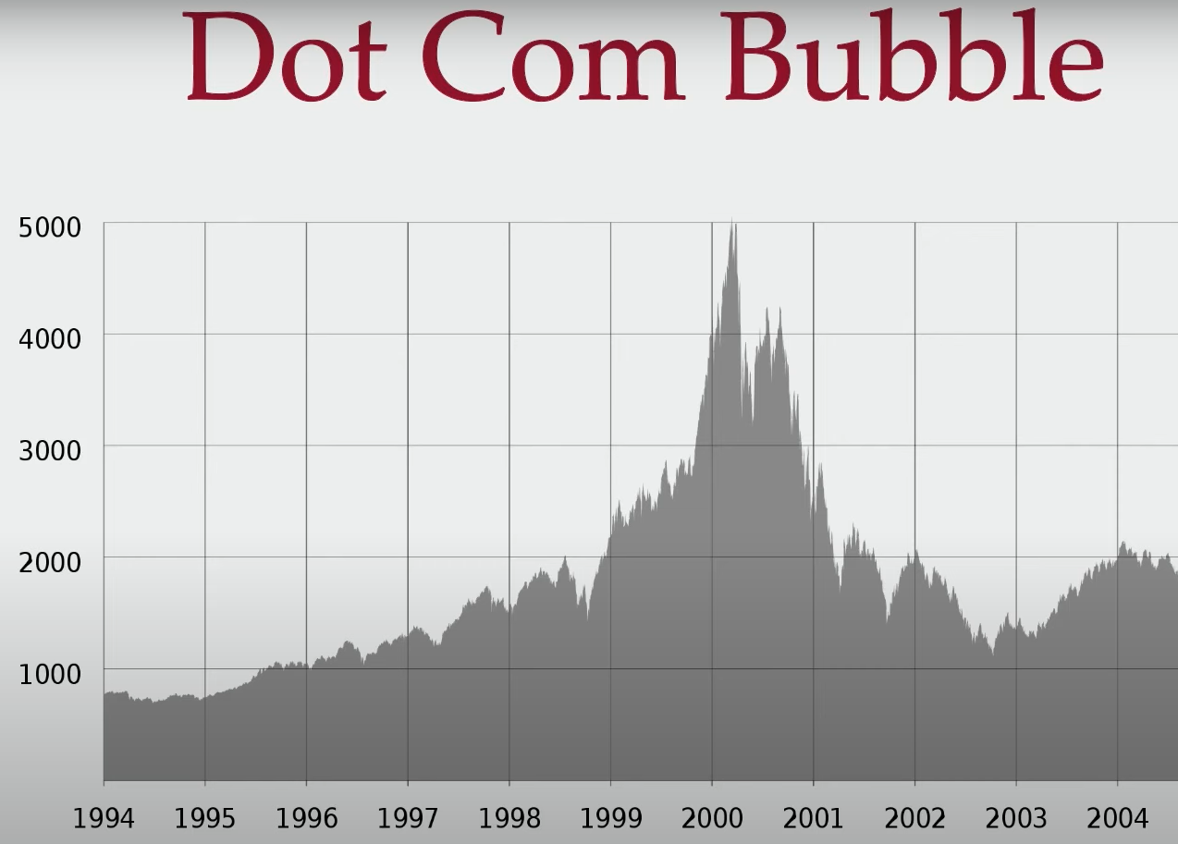

Slide 24
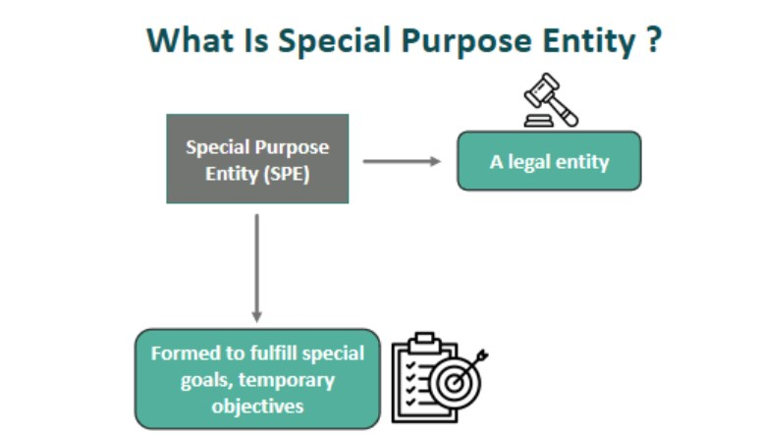
4. Special Purpose Entity

Slide 25
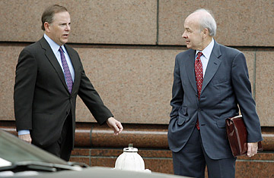
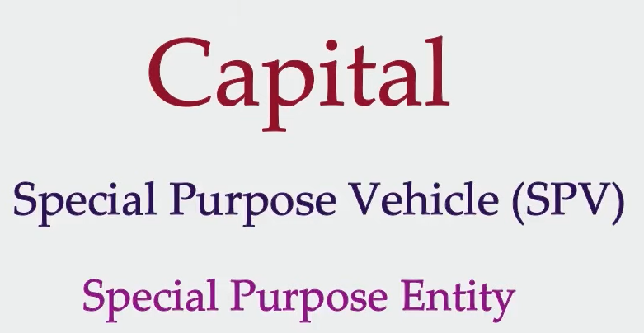

Slide 26
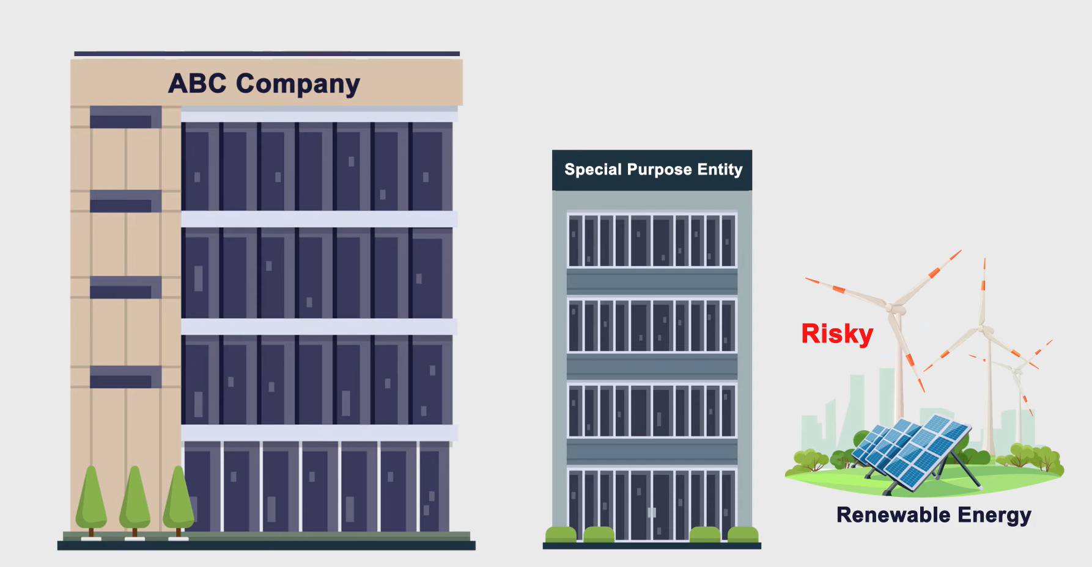

Slide 27
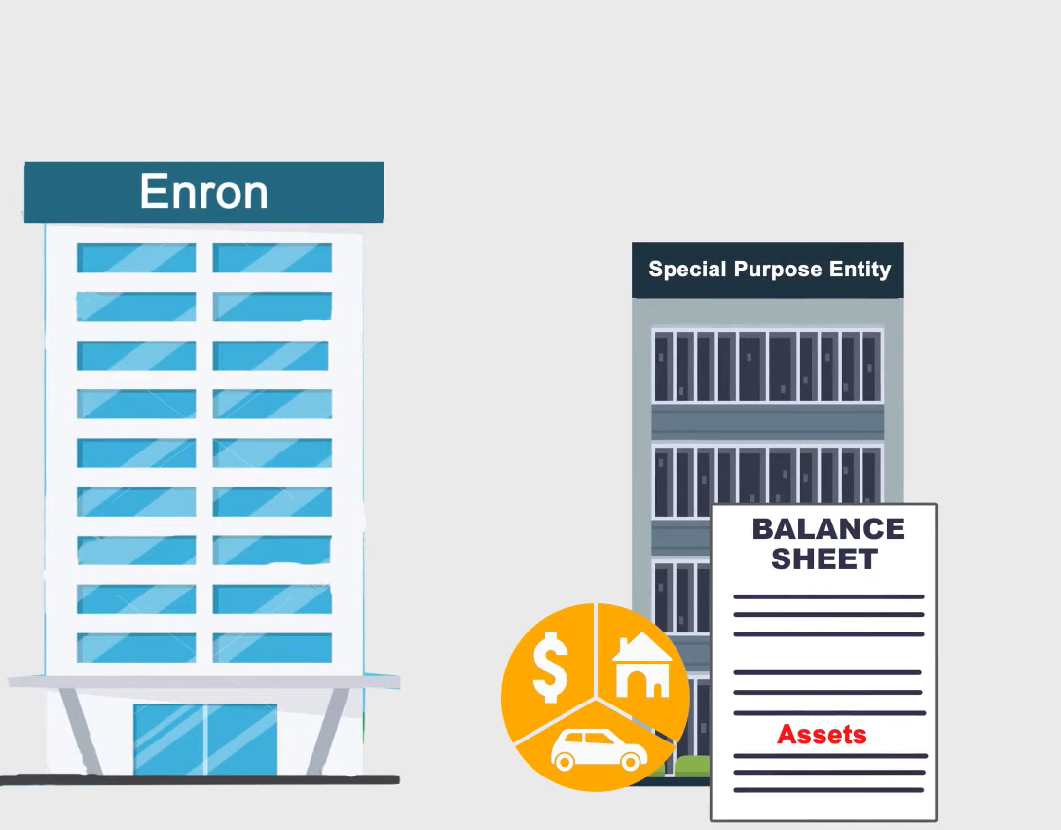
Transfer Assets

Slide 28
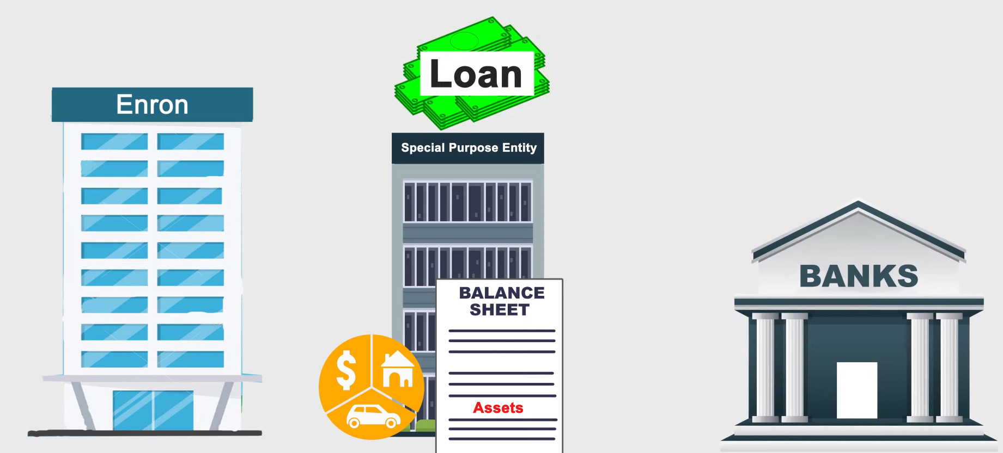

Slide 29
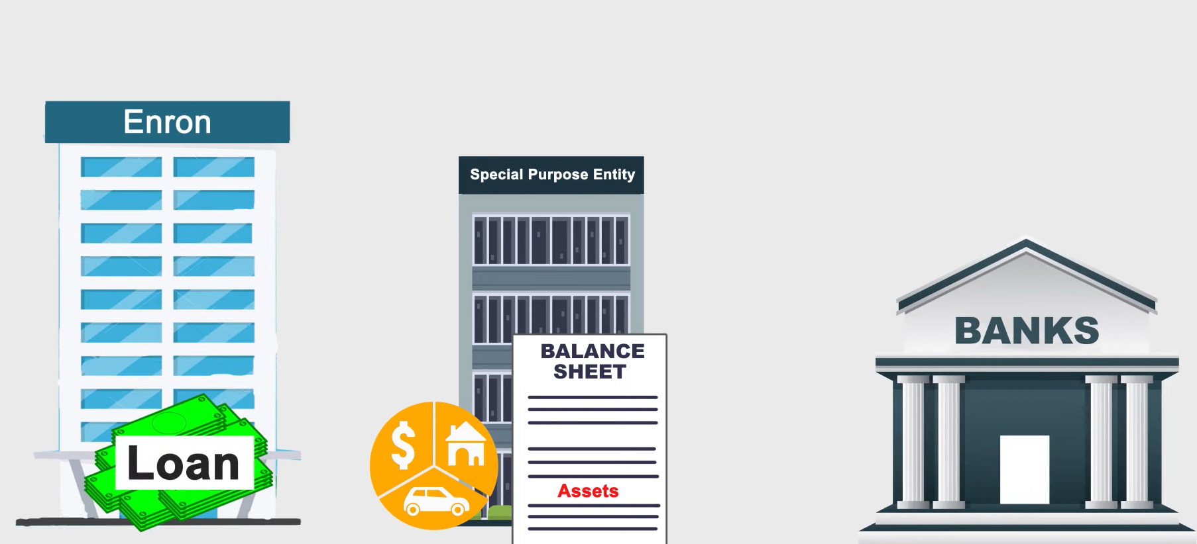
Raised Capital

Slide 30

Why All This??

Slide 31

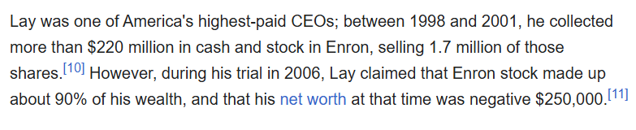
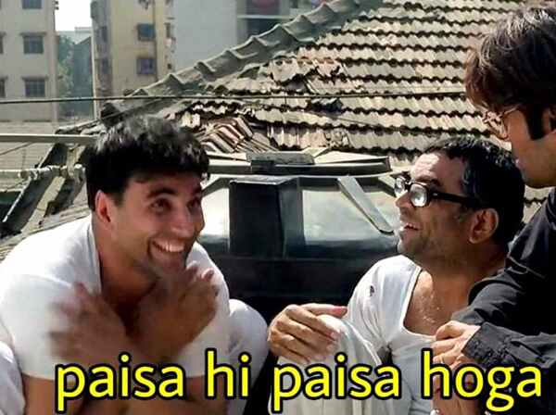
Because

Slide 32
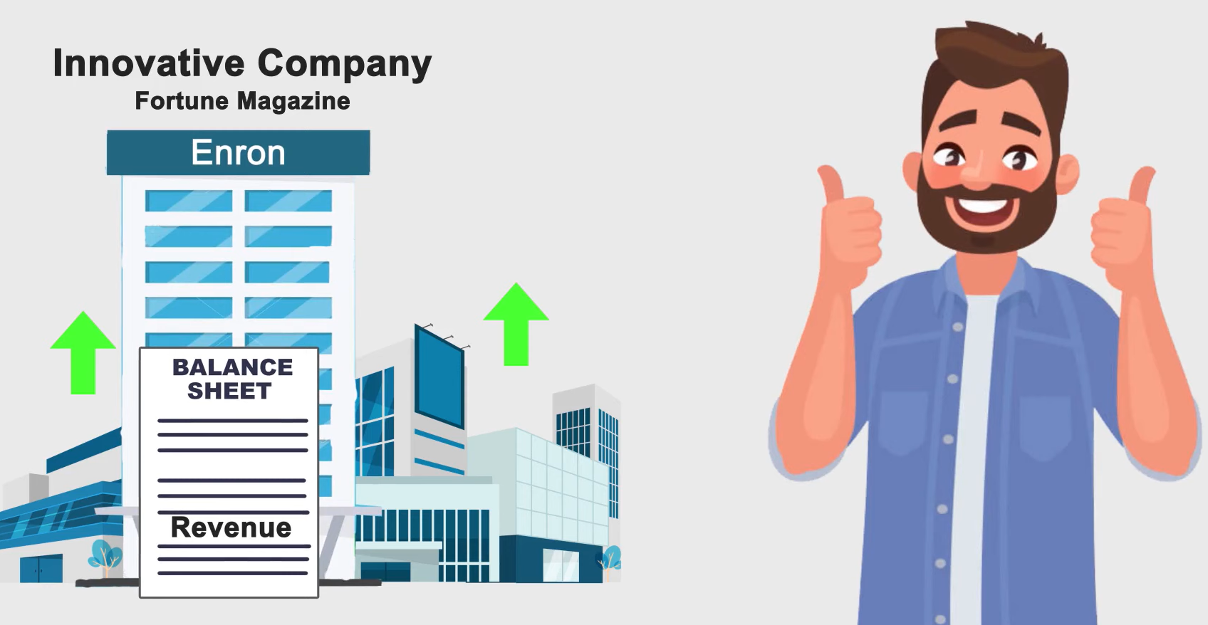
5. Revenue and Profit
Transferred Assets were billed as sales

Slide 33
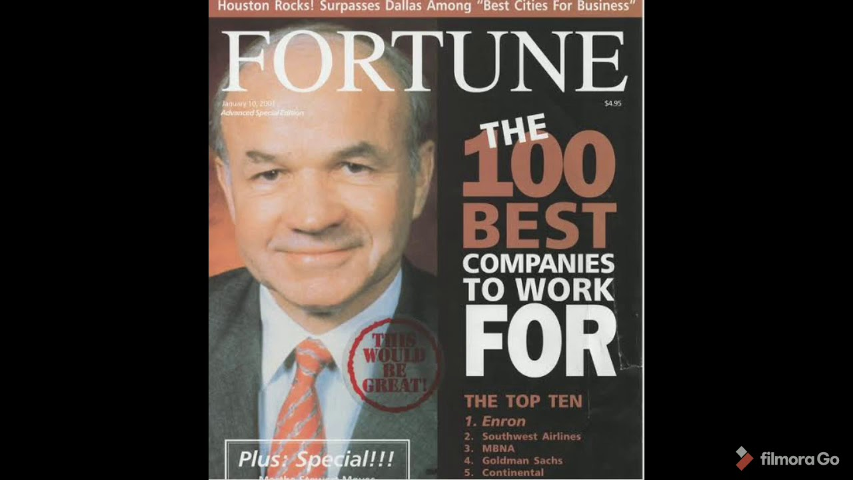
6 Years on Fortune Magazine

Slide 34
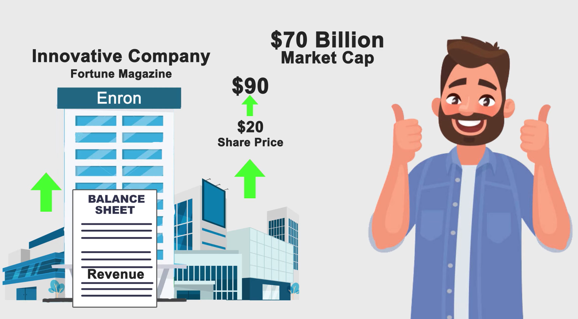

Slide 35
Role of Arthur Anderson
Enron's external auditor
Destruction of critical documents
Failure to highlight financial irregularities

Slide 36
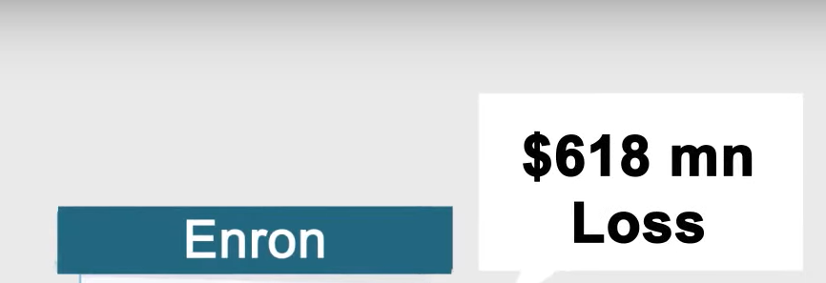

Oct 2001

Slide 37
Signs of Trouble
Stock price fluctuations
Employee whistleblowers
Analyst concerns about lack of transparency

Slide 38
Unravelling of Enron
Market reaction and loss of investor confidence
Jeffrey Skilling resigns in 2001
SEC investigation begins

Slide 39
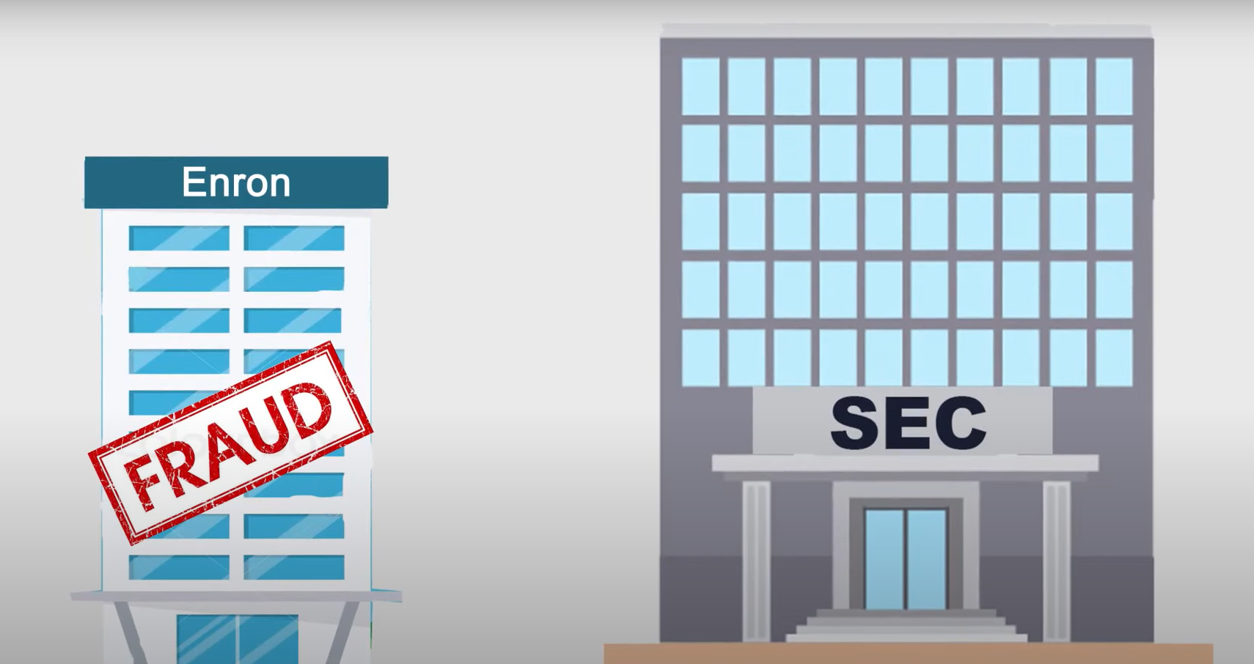

Slide 40
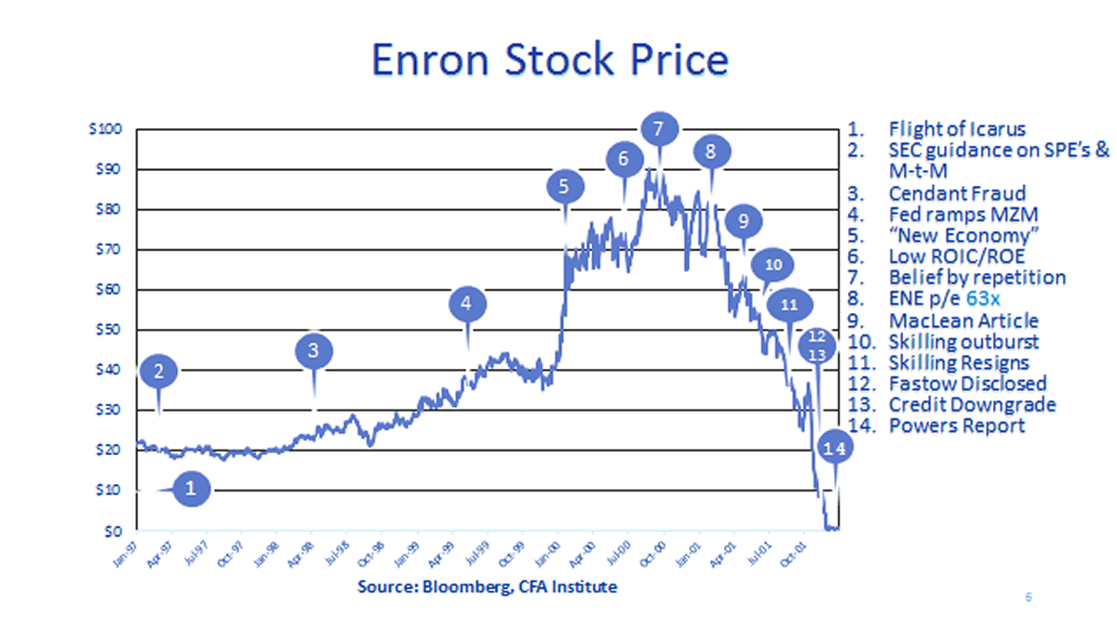

Slide 41
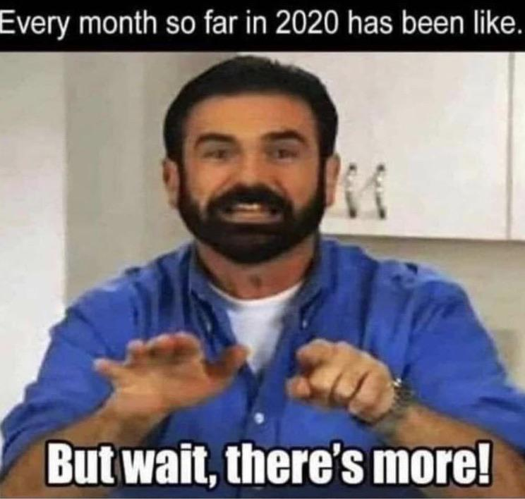

Slide 42
Others Corporate Scandals Inspired
WorldCom
→ Telecommunications Scandal Overstating $3.8 Billion
Lehman Brothers
→ Major Investment Bank investing in risky mortgages leading massive bankruptcy contributing to 2008 crisis
Bernie Madoff Ponzi Scheme
→ Stock and Securities fraud in 2008

Slide 43
Backlogs
Investors Lost Billions
CEO and COO charged for Fraud
Thousand Lost Jobs
Emotional and Financial Damage
Damage to public trust on public companies

Slide 44
Takeaway
Importance of transparency in financial reporting
Need for ethical corporate governance
Role of auditors in preventing fraud

Slide 45
Short Summary
1992
Accounting Methods Change
2000
High Valued Company
2000
Filed For Bankruptcy

Slide 46
Lessons Learned
1. Ethical Leadership Robust corporate culture promoting integrity at all levels
2. Effective Internal Controls
Strong, regularly reviewed audit processes and internal controls
3. Independent Oversight
Active, engaged boards with diverse skills and perspectives
4. Transparent Communication
Clear, honest reporting to stakeholders
5. Responsive Regulatory Environment
Adaptive laws and regulations ensuring accountability

Slide 47
Still a Legacy
Case study in business schools
Ongoing discussions on corporate ethics
Influence on financial regulations
Documentaries and books on Enron
Cultural impact and portrayal in media
Continued discussions on corporate fraud

Slide 48
Current Corporate Governance Trends
Increased regulatory scrutiny
Ethical investment strategies
Greater emphasis on corporate social responsibility (CSR)

Slide 49
Video
The Enron Scandal - An Animated Overview (in 2 minutes)
https://www.youtube.com/watch?v=vMj0t2Vsyvs

Slide 50
Sources
https://www.britannica.com/event/Enron-scandal/Downfall-and-bankruptcy
https://www.fbi.gov/history/famous-cases/enron
https://www.investopedia.com/updates/enron-scandal-summary/
https://www.learnsignal.com/blog/the-enron-scandal-overview/
https://internationalbanker.com/history-of-financial-crises/the-enron-scandal-2001/
Aduda, Chogii & Magutu (2013). An empirical test of competiting corporate governance theories
Babic, Jelena & Jelena (2010). Rethinking Board Role Performance: Toward An Integral Model (1-23).

Slide 51
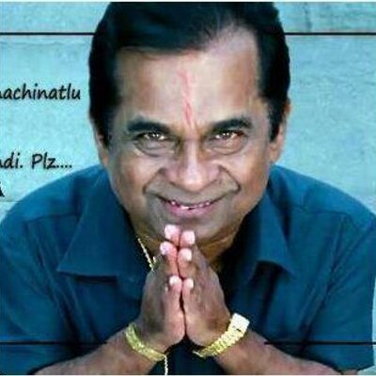


Slide 52


